Slide 1

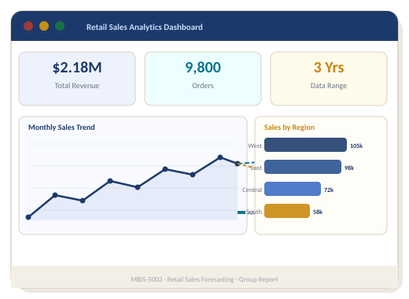

Retail Sales
Forecasting
Using ARIMA & Prophet Time Series Models
MBIS-5003 · Assignment 3 (Task C) · Group Report
Group Members
Ahmed Al Rafsan (234856)
Fateha Haque (234724) · Abdul Rahman Mohammed Saber (236009)
March 2026 · Australian Institute of Higher Education

Slide 2

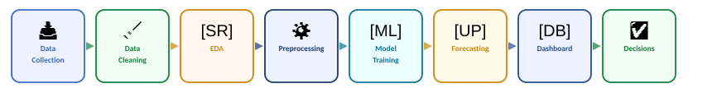

Project Overview
End-to-end data analytics pipeline for retail sales prediction
Goal
Scope
Outcome
Predict future retail sales using 3 years of historical e-commerce transaction data to enable smarter business decisions.
9,800+ daily records (Jan 2021–Dec 2023) across 4 regions and 3 product categories, aggregated to 36 monthly periods.
Visual dashboards (Power BI) delivering actionable insights for inventory, supply chain, and marketing optimisation.
MBIS-5003 · Retail Sales Forecasting · ARIMA & Prophet Comparative Analysis

Slide 3

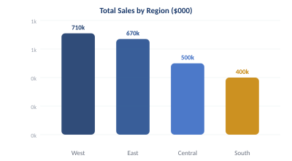
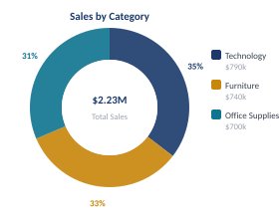
Dataset Overview
Kaggle Retail Sales Dataset · 1,095 daily records aggregated to 36 monthly periods
9,800+
3 Years
4
3
Transaction Records
Jan 2021 – Dec 2023
Regions
Product Categories
Key Dataset Variables
Order Date
Transaction timestamp
Sales Value
Revenue per order (USD)
Product Category
Furniture · Office Supplies · Technology
Region
Central · East · South · West
Customer Segment
Consumer · Corporate · Home Office
MBIS-5003 · Retail Sales Forecasting · ARIMA & Prophet Comparative Analysis

Slide 4

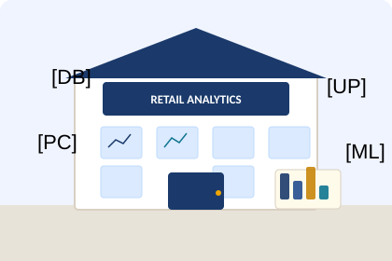
Data Preparation & Exploratory Analysis
5-step preprocessing pipeline + EDA insights
1
Date Conversion
Order Date parsed → Python datetime format
2
Index Setting
Date column set as time-series index
3
Frequency Aggregation
Daily records resampled to monthly totals (ME)
4
Deduplication
Duplicate transactions removed for data integrity
[UP] Upward Trend
🔄 Seasonal Peaks
5
Consistent monthly growth 2021–2023
Higher demand in Q2 and Q4
Train / Test Split
80% train (Jan 2021–Apr 2023) · 20% test (May–Dec 2023)
🗺️ Regional Leaders
🏷️ Top Category
West & East drive highest revenue
Technology leads all product sales
MBIS-5003 · Retail Sales Forecasting · ARIMA & Prophet Comparative Analysis

Slide 5

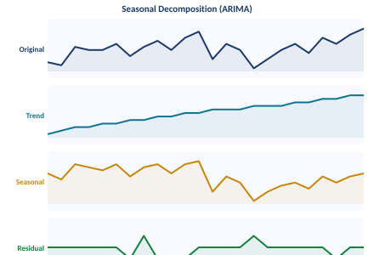
Forecasting Model Implementation
ARIMA (1,1,1) vs Facebook Prophet — configurations & equations
ARIMA (1, 1, 1)
Facebook Prophet
y_t = c + φ₁y_{t-1} + θ₁ε_{t-1} + ε_t
y(t) = g(t) + s(t) + h(t) + ε(t)
AR (p=1):
Uses past sales values to predict future
g(t):
Trend: long-term growth direction
I (d=1):
1st differencing → stationarity achieved
s(t):
Seasonality: yearly + weekly + monthly (Fourier 5)
MA (q=1):
Uses past forecast errors in model
h(t):
Holidays & discrete event effects
ADF Test:
Original: p=0.9519 (non-stationary) → after diff: p<0.001 OK
Changepoint:
prior_scale=0.05 for controlled flexibility
Training:
Jan 2021–Apr 2023 · 28 months · 80% of data
CI:
95% confidence intervals (interval_width=0.95)
Testing:
May 2023–Dec 2023 · 8 months · 20% of data
Period:
Custom monthly seasonality: 30.5 days
Data Split: 80% Training (Jan 2021–Apr 2023) | 20% Testing (May–Dec 2023)

Slide 6
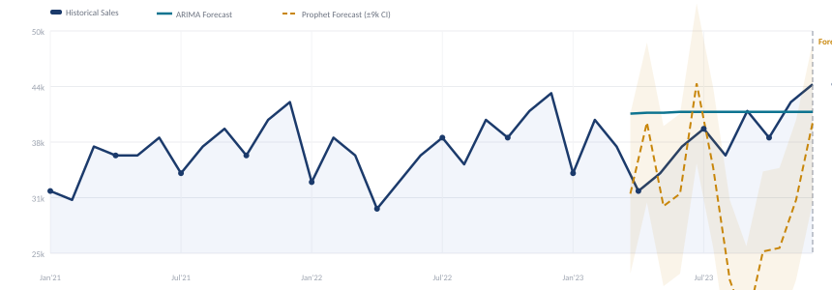
12-Month Forecast Results
Full time-series chart with historical data, ARIMA trend & Prophet seasonal forecast
ARIMA Forecast — 2024
Prophet Forecast — Test Period
Month | Predicted Sales
Jan 2024 | 40,757
Feb 2024 | 40,819
Mar 2024 | 40,851
Apr 2024 | 40,867
May 2024 | 40,875
Jun 2024 | 40,880
Jul–Dec 2024 | ~40,882–40,884
Month | Predicted Sales
May 2023 | 30,017
Jun 2023 | 44,116
Jul 2023 | 34,621
Aug 2023 | 21,987
Sep 2023 | 16,779
Oct 2023 | 25,171
Nov–Dec 2023 | 25,577–30,990
ARIMA stabilises ~40,880 (< 0.31% growth) | Prophet cycles: peak Jun 44,116 ↔ trough Sep 16,779 | Uncertainty ±9,005

Slide 7
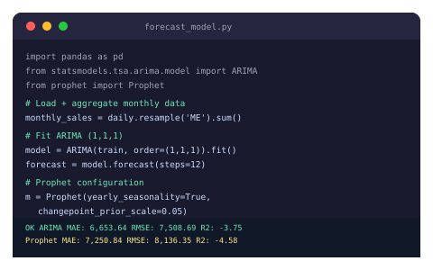
ARIMA Model Deep Dive
Seasonal decomposition: Trend · Seasonality · Residual components
Non-Stationary → Stationary
ADF: p=0.9519 → after 1st differencing p<0.001
Parameters (1,1,1)
p=AR order, d=diff order, q=MA order — selected via ACF/PACF
Stable Predictions
Converges to ~40,880 with diminishing growth rate < 0.31%
Training AIC: 509.67
Lower AIC confirms good model fit with minimal complexity penalty
SARIMAX Results: AIC=509.67 · BIC=513.56 · Log Likelihood=−251.84

Slide 8
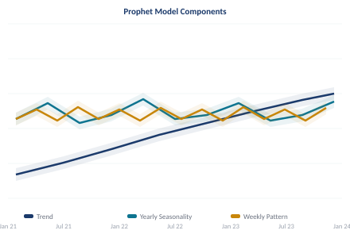
Prophet Model Deep Dive
Decomposable time-series: Trend + Yearly + Weekly + Monthly components
Trend Changepoints
25 auto-detected changepoints with scale=0.05 for smooth trend
Yearly Seasonality
Strong annual patterns — peaks in Q2 (June) and Q4
Weekly Effects
Weekends show higher consumer demand vs weekdays
95% Confidence Bands
Prediction uncertainty ±9,005 — crucial for risk management
Prophet equation: y(t) = g(t) + s(t) + h(t) + ε(t) · Fourier order=5 · period=30.5 days

Slide 9

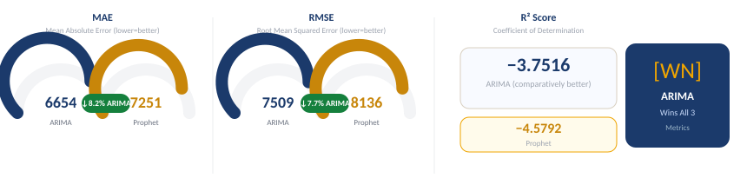
Accuracy Metrics
Statistical evaluation: MAE · RMSE · R² — comparing ARIMA vs Prophet prediction quality
MAE — Mean Absolute Error
RMSE — Root Mean Squared Error
R² — Coefficient of Determination
Average of absolute differences between predicted and actual values. ARIMA scores 8.2% lower — more accurate predictions on average.
Square root of average squared errors. Penalises large errors more heavily. ARIMA 7.7% better — fewer extreme prediction mistakes.
Proportion of variance explained. Both negative due to high data volatility — but ARIMA's −3.75 is comparatively superior to −4.58.
ARIMA: 6,653.64
Prophet: 7,250.84
ARIMA: 7,508.69
Prophet: 8,136.35
ARIMA: −3.7516
Prophet: −4.5792
Result: ARIMA wins all 3 accuracy metrics — more reliable forecasts for this retail dataset

Slide 10

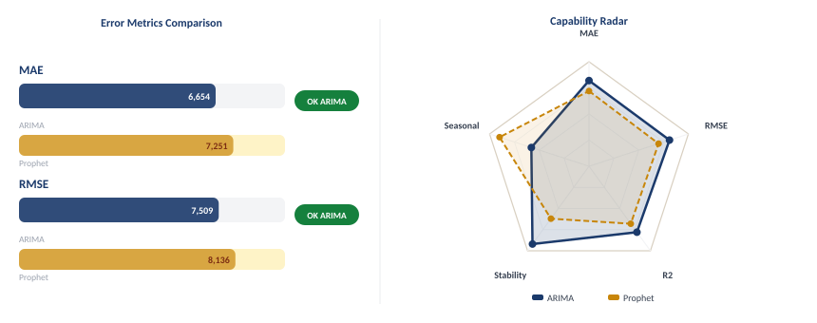
Model Comparison
Side-by-side evaluation across error metrics, capability radar & forecast characteristics
[WN] ARIMA wins MAE (−8.2%) · RMSE (−7.7%) · R² (−18.1%) | ARIMA: stable operational planning | Prophet: superior seasonal pattern detection
Recommendation: Use ARIMA for operational decisions · Prophet for seasonal strategy · Ensemble approach for maximum insight

Slide 11

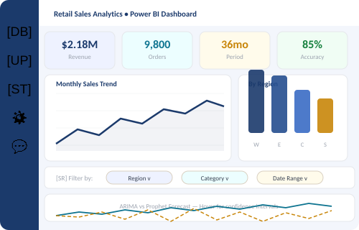
Dashboard & Visual Analytics
Microsoft Power BI · Interactive filters by Region, Category & Time Period
[UP] Historical Sales Trend
Line chart · Monthly sales 2015–2018 with seasonal peaks Q2 & Q4
🗺️ Regional Performance
Bar chart · West & East dominate; drill-down by geography
🏷️ Product Category
Bar chart · Technology leads; Office Supplies & Furniture follow
🔮 ARIMA vs Prophet
Combo chart · Predicted vs actual overlay with 95% CI bands
MBIS-5003 · Retail Sales Forecasting · ARIMA & Prophet Comparative Analysis

Slide 12




Business Insights & Recommendations
Translating forecasting results into actionable operational strategy
Inventory Management
Supply Chain Planning
Use ARIMA forecasts (~40,880) for baseline stock. Prepare safety stock for Prophet-predicted peaks in June & February.
Coordinate production, logistics, and distribution ahead of predicted high-demand months to reduce operational cost.
Marketing Strategy
Risk Management
Schedule campaigns aligned with Prophet-detected seasonal peaks (June & February) to maximise promotional ROI.
Use Prophet's 95% confidence intervals (±9,005) to plan contingency budgets and buffer stock for high-uncertainty periods.
ARIMA → Short-term operations · Prophet → Seasonal strategy · Ensemble → Most complete business intelligence

Slide 13
Conclusion
ARIMA outperforms Prophet
Lower MAE (6,654 vs 7,251), RMSE (7,509 vs 8,136), higher R²
Stable operational planning
ARIMA forecasts stabilise ~40,880 — ideal for inventory & staffing
Seasonal strategic insight
Prophet reveals Jun peak (44k) and Sep trough (17k) for campaigns
Best-of-both approach
Combining both models delivers the most complete intelligence
Dashboard-driven decisions
Power BI transforms complex outputs into actionable business insight
MBIS-5003 · Ahmed Al Rafsan · Fateha Haque · Abdul Rahman Mohammed Saber · March 2026

